Slide 1

The Jedi’s
Ammar Mehicevic
Tony Lam
Etienne Laccruche

Slide 2
TAP
Technology Ambassador Program
Established in 2012
To increase the number of students in Information Technology (IT) majors
A focused commitment to service learning

Slide 3
Goals
This study is geared towards kids who wouldn’t normally think about IT as “cool” or “fun”
Use active learning to ignite interest in youth about tech
This project shows how IT can be cool and creative

Slide 4
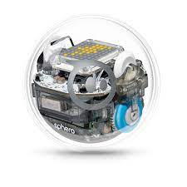

Project Description
Program a robot through a maze using Sphero EDU
Learn about block coding and algorithms
Sphero is a small robot ball that moves around by either remote control or code you feed it

Slide 5
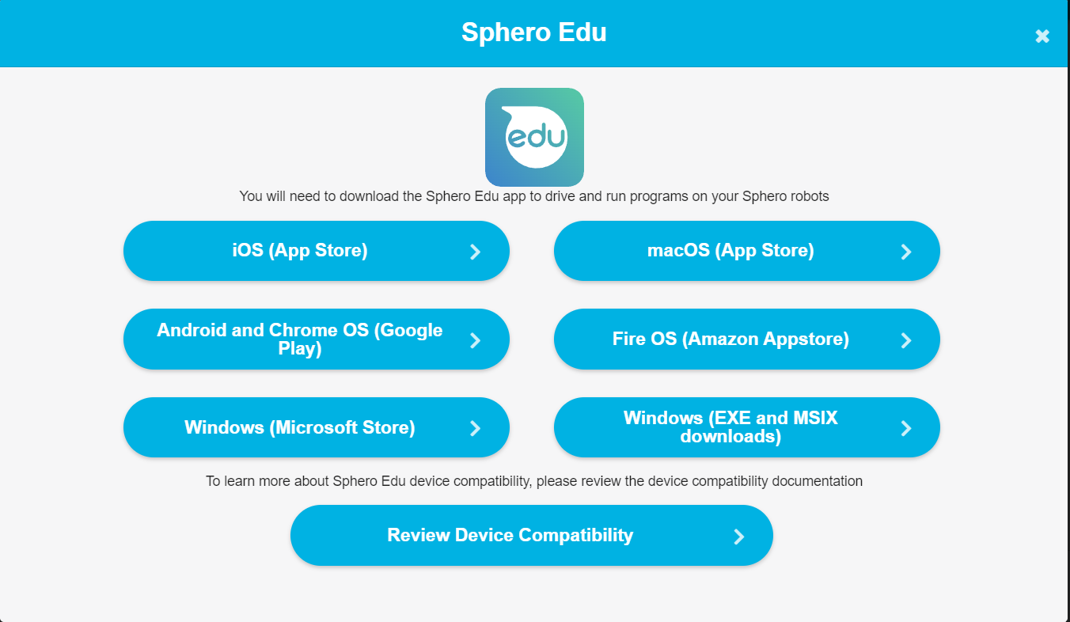
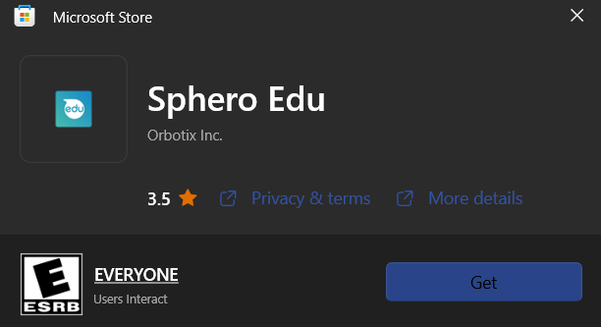
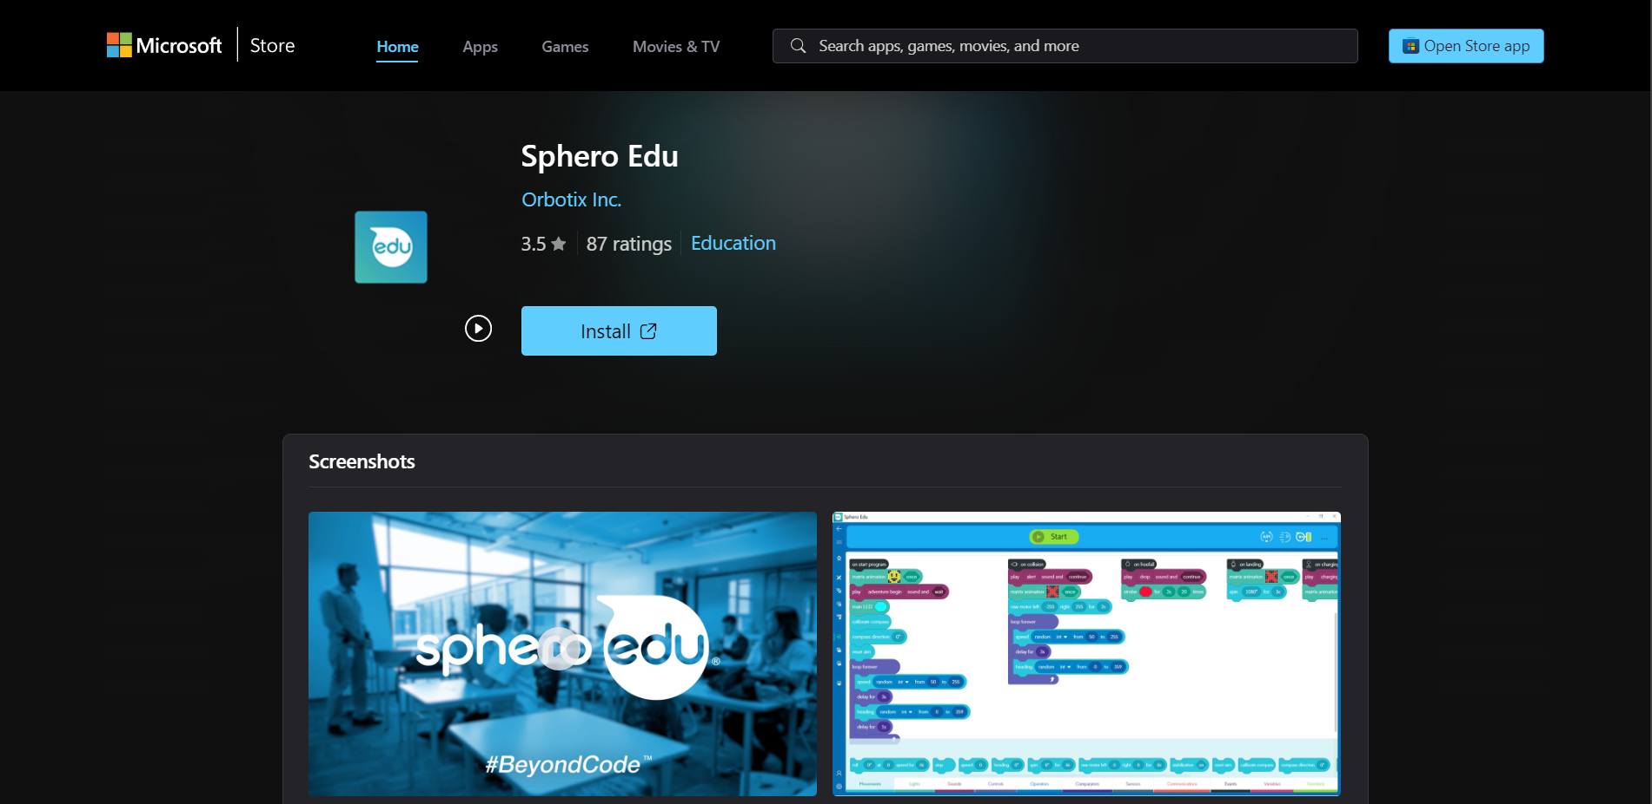
Downloading Sphero EDU
https://edu.sphero.com/downloads

Slide 6

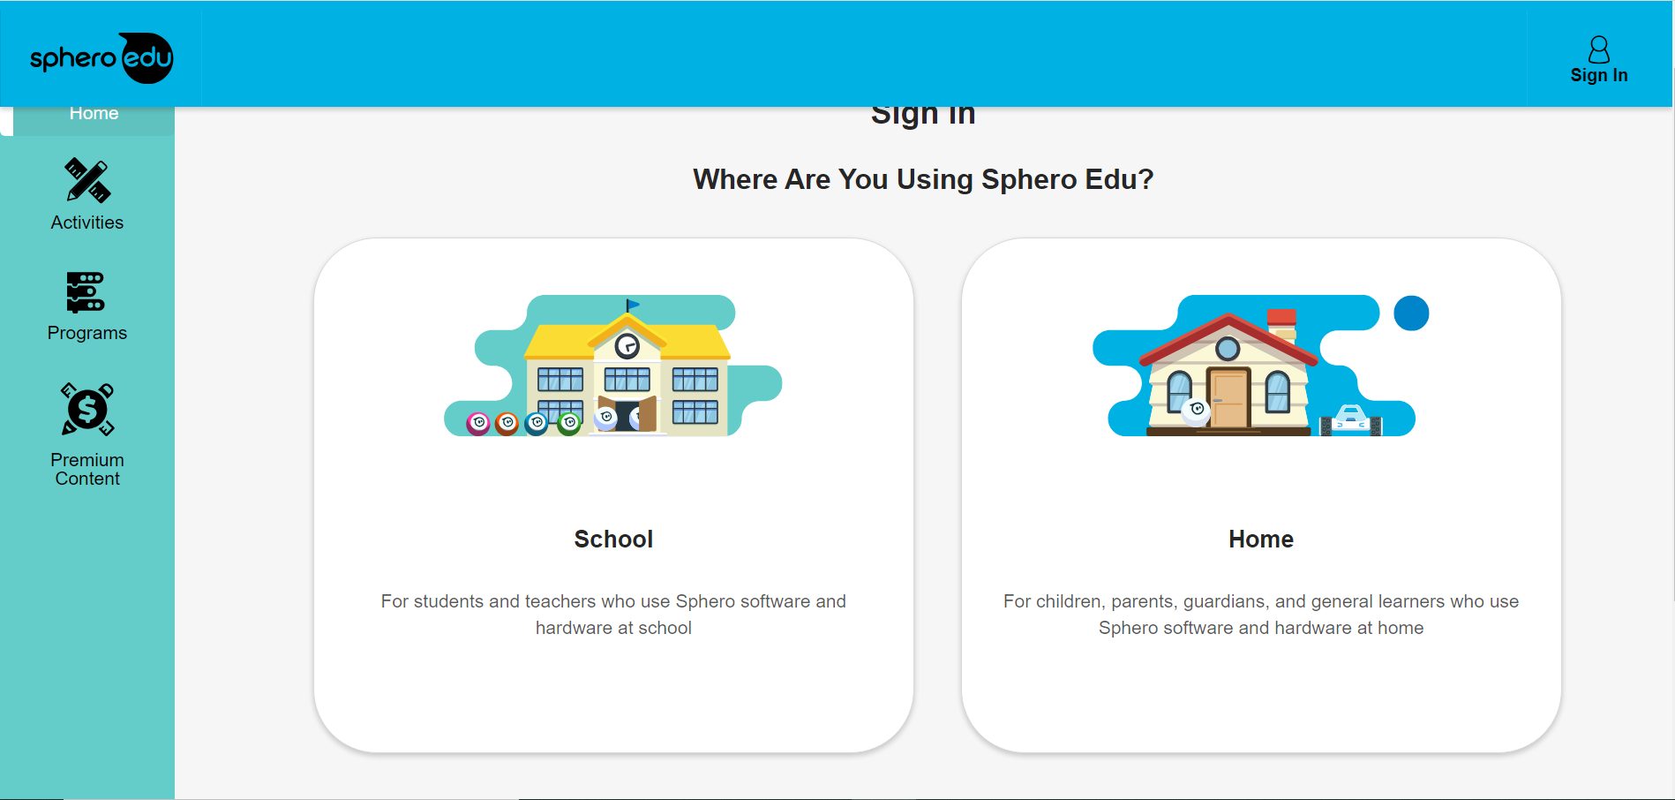
Type spheroEDU in the search bar next to the windows logo and open it
Choose School user

Slide 7
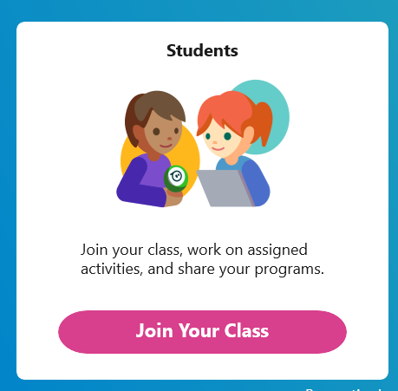
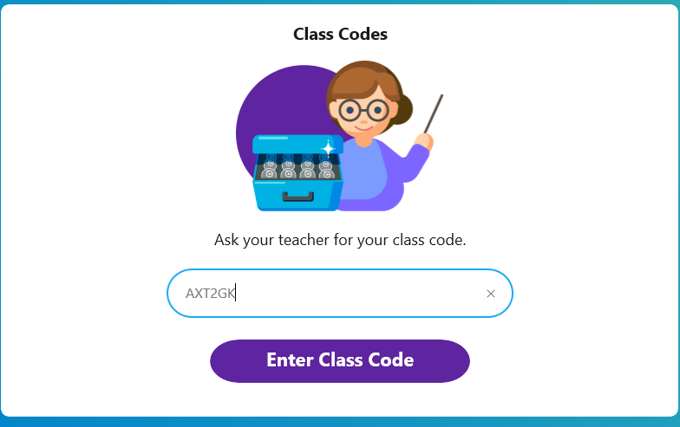
Join The Class!

Slide 8
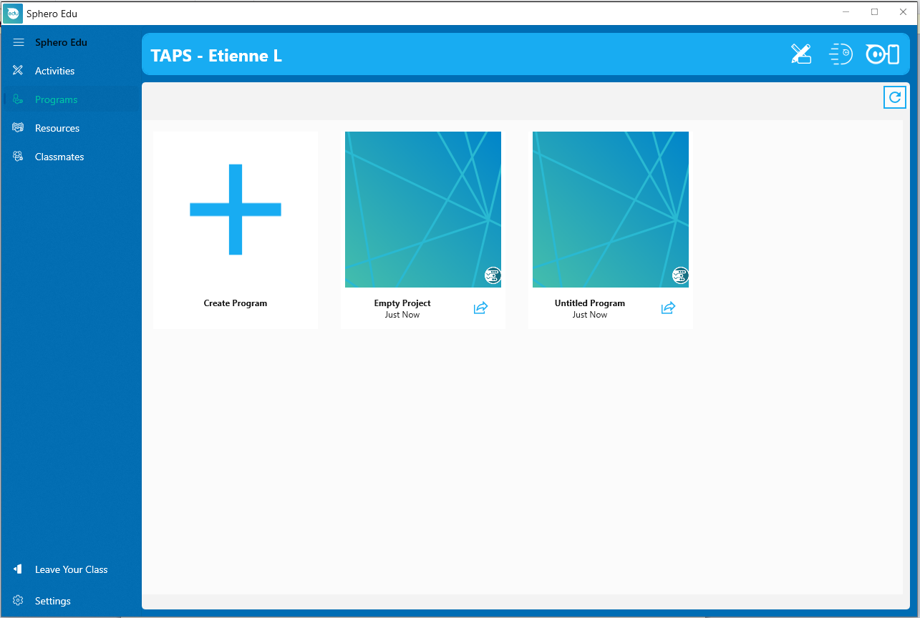
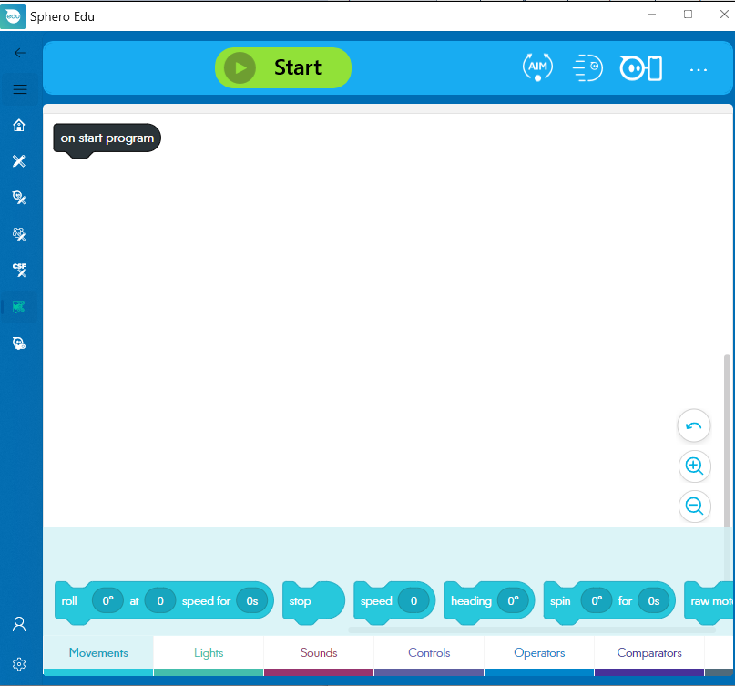
Workshop
Open Sphero Edu on your computer or phone.
Once in the app click on “My Programs” and click on “Create Program”

Slide 9
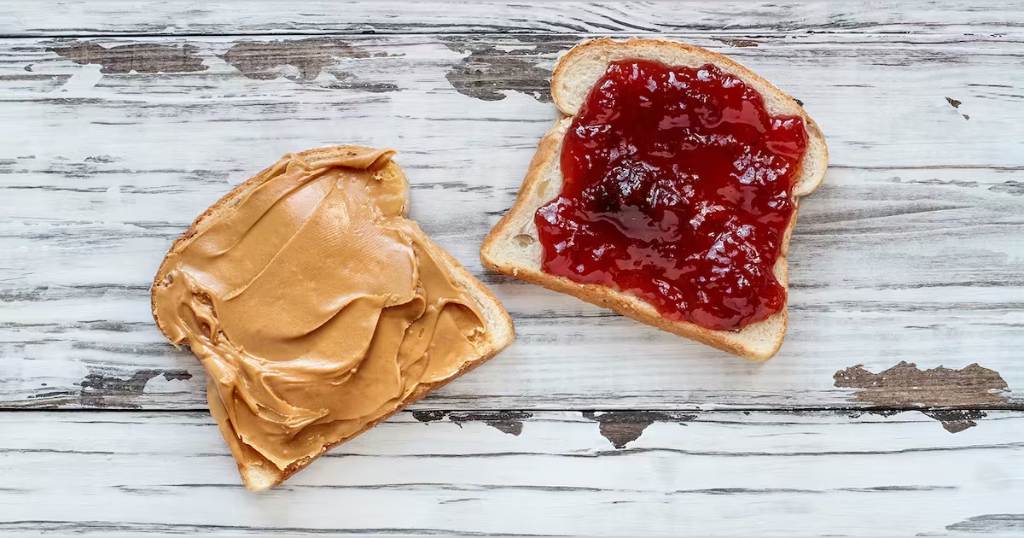
Quick Exercise

Slide 10
That's an Algorithm!
A set of instructions (or steps) to solve a problem or perform a task.

Slide 11
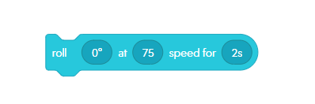
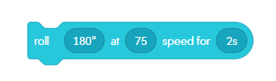
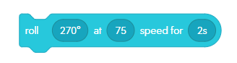
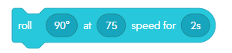
Forward
Backward
Left
Right

Slide 12
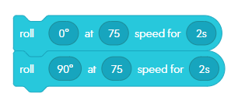
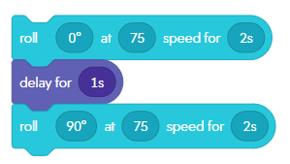
Delay vs No Delay

Slide 13
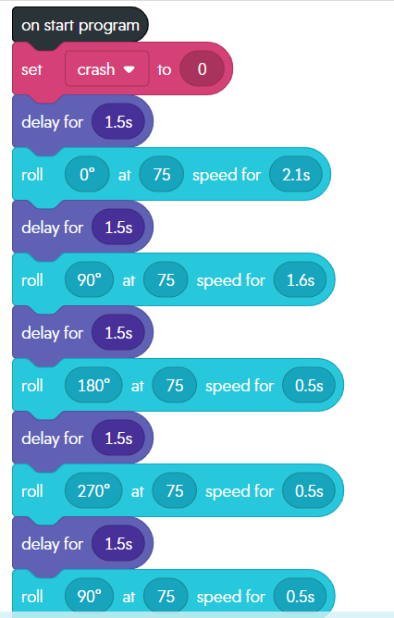
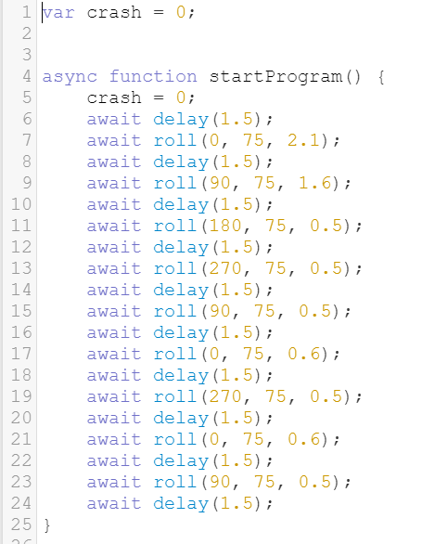
Block Code vs Scripting

Slide 14
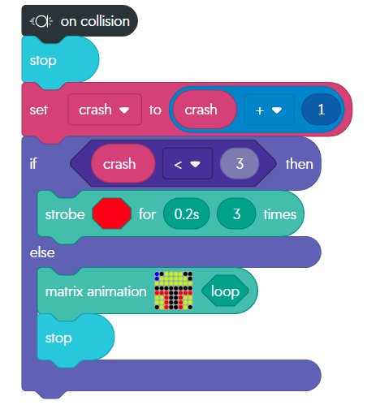
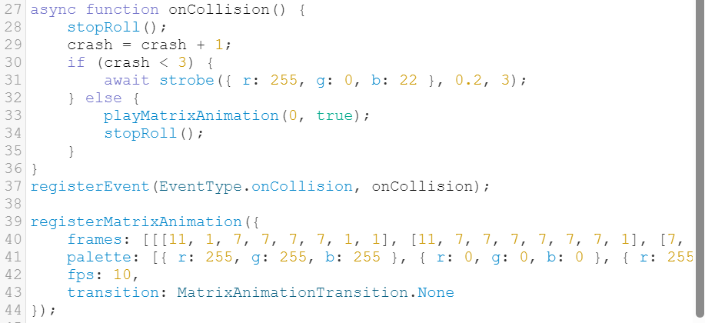
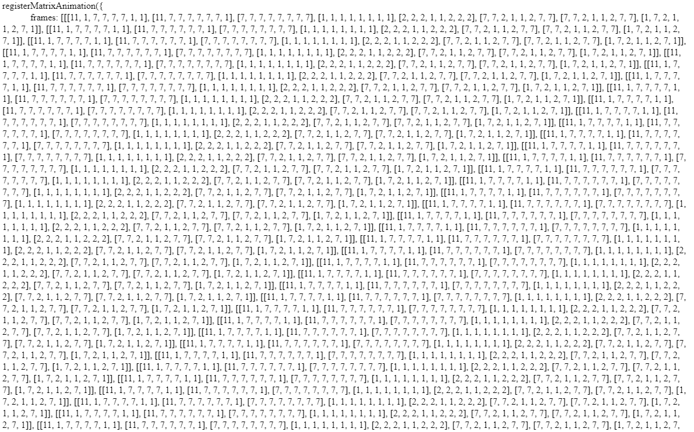
Block Code vs Scripting

Slide 15
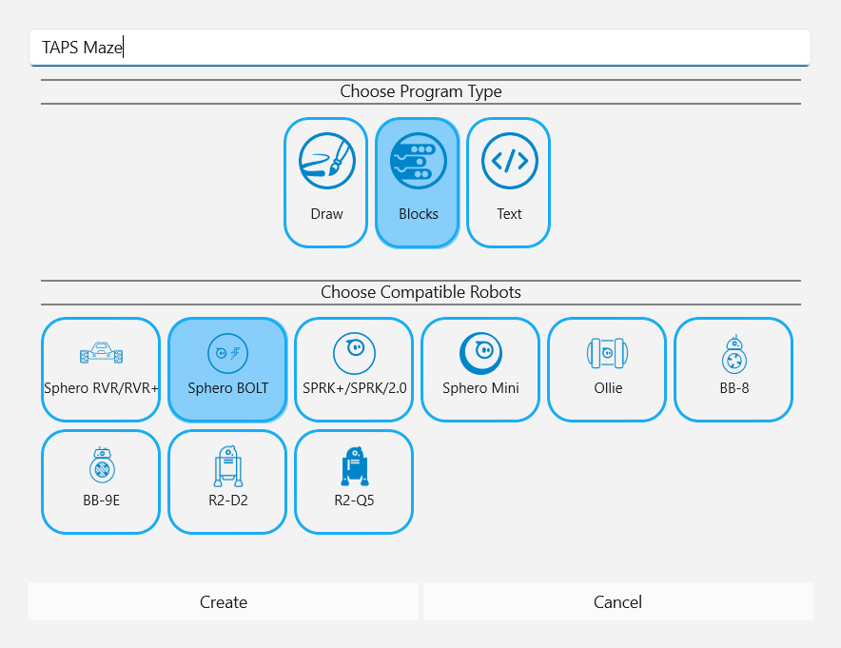
Name the Program “TAPS Maze”
Make sure “Blocks” and “Sphero Bolt” are selected and click Create at the bottom

Slide 16
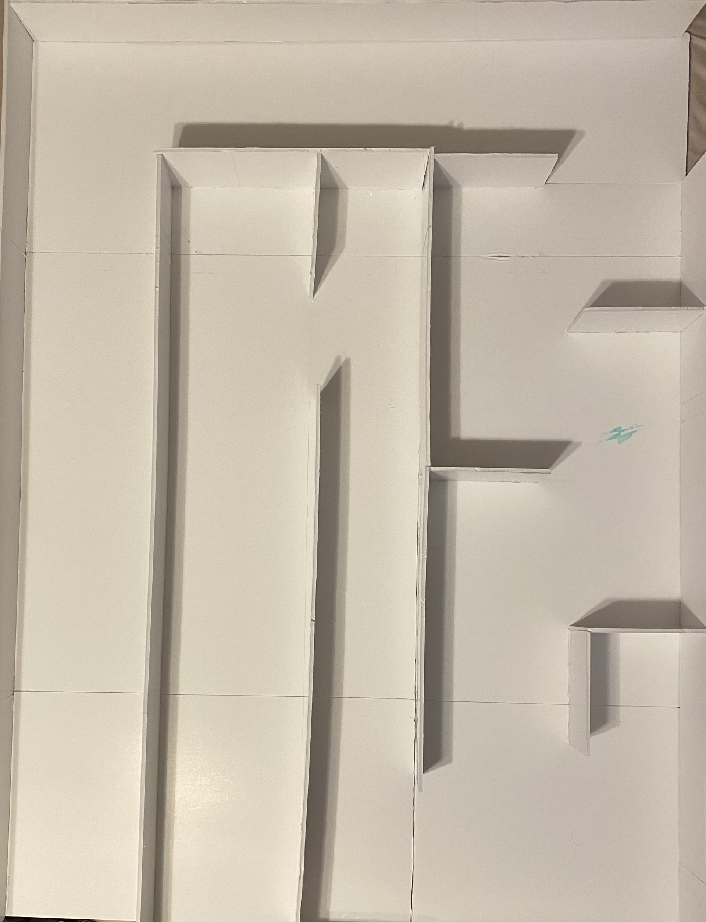
Let's Figure This One Out

Slide 17
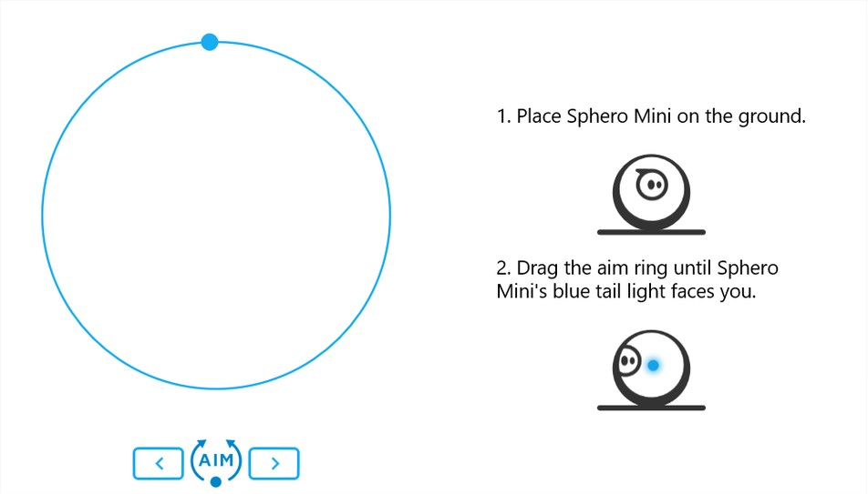
Make Sure You’re Going Straight

Slide 18
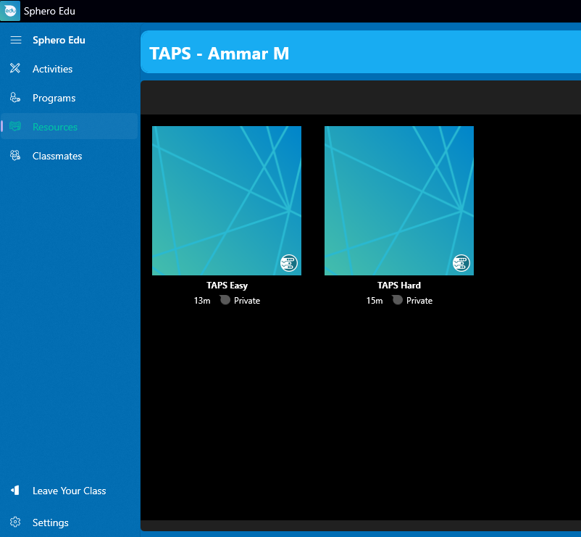
To Start Easy Code

Slide 19
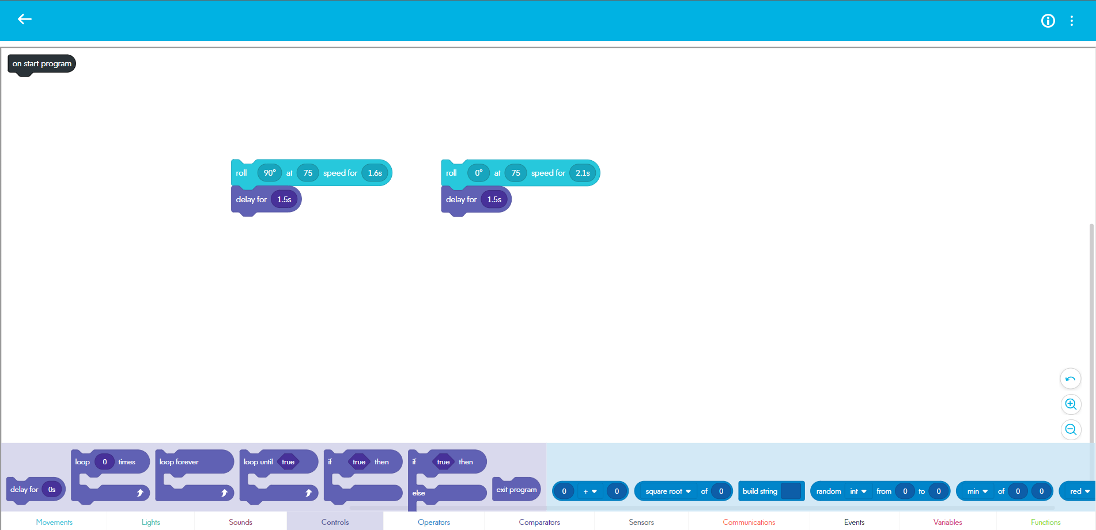
TAPS Easy

Slide 20
To Start Hard Code

Slide 21
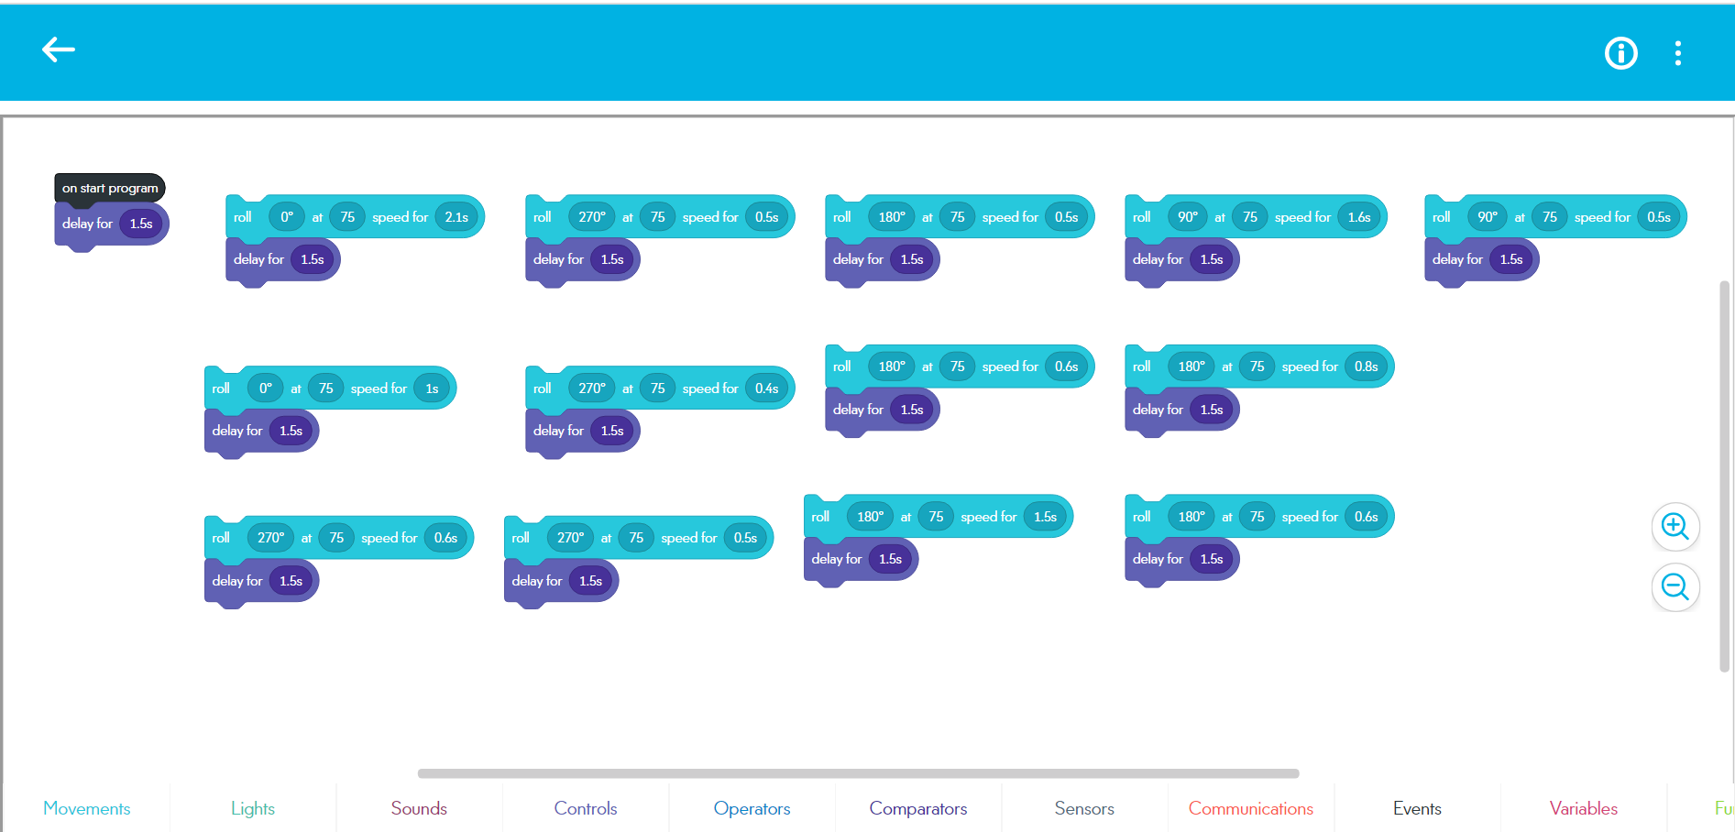
TAPS Hard

Slide 22
1
2
Finish

Slide 23
1
2
4
3
9
10
6
5
7
11
Finish
8

Slide 24
Survey Time

Slide 25
Thank You
Questions?

